Slide 1

Cyclistic Conversion Strategy 2019-2020 Growth Analysis
Identifying Behavioral Trends to Convert Casual Riders into Annual Members
Analysis done by Samuel Sanni (Junior Date Analyst) on 2026/1/2

Slide 2

Business Task
To identify usage differences between members and casual riders to inform digital marketing strategies.

Slide 3
Analysis Overview
This project followed the standard Data Analysis process: Ask, Prepare, Process, Analyze, Share, and Act.
Toolkit:
Spreadsheets: Initial data exploration.
SQL (BigQuery): Processing and cleaning large datasets.
R (RStudio): Statistical analysis and data transformation.
Tableau: Final data visualization and dashboarding.

Slide 4
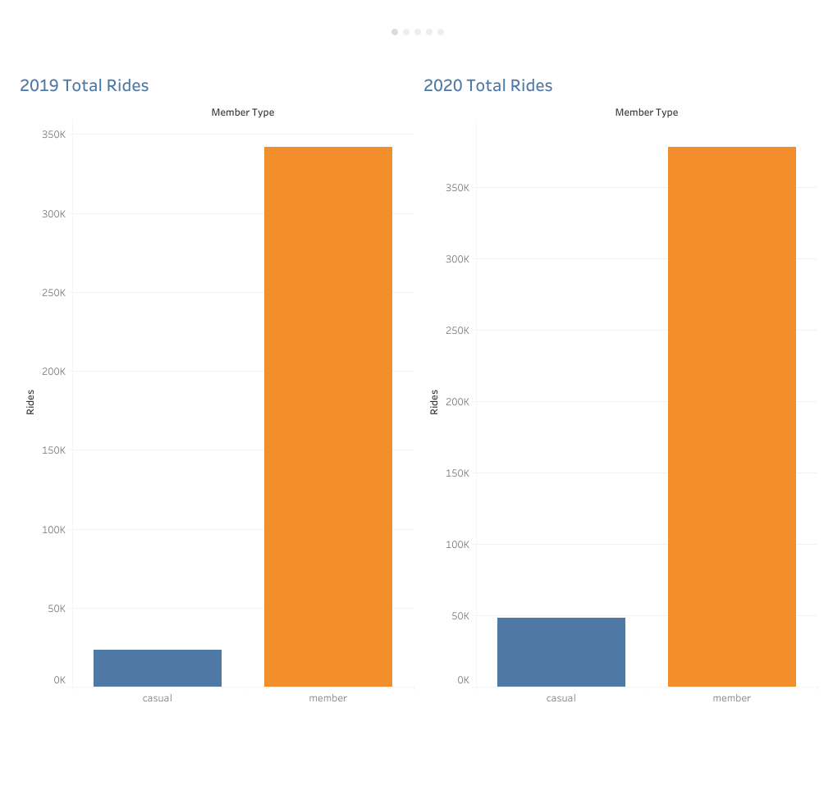
Annual Members Account for Most Cyclistic Rides
Members dominate total rides in both 2019 and 2020.
Casual ridership increased in 2020, showing significant growth potential.

Slide 5
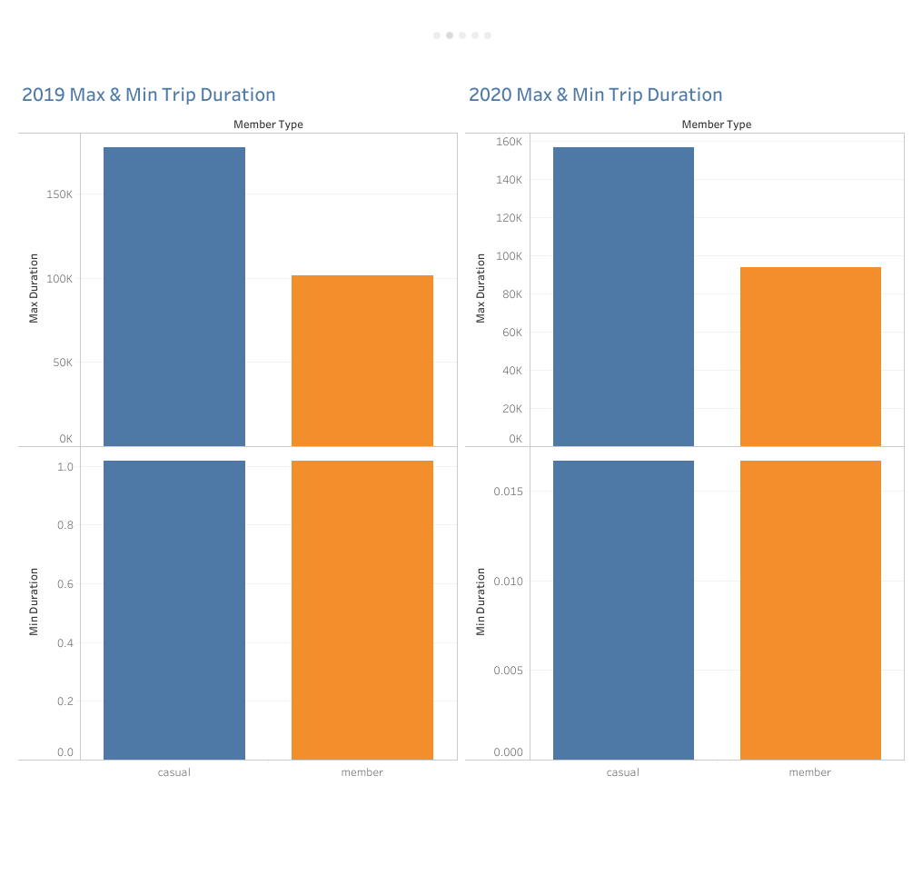
Casual Riders Lead in Trip Duration
Max trip durations for casual riders consistently double those of members in both years.

Slide 6
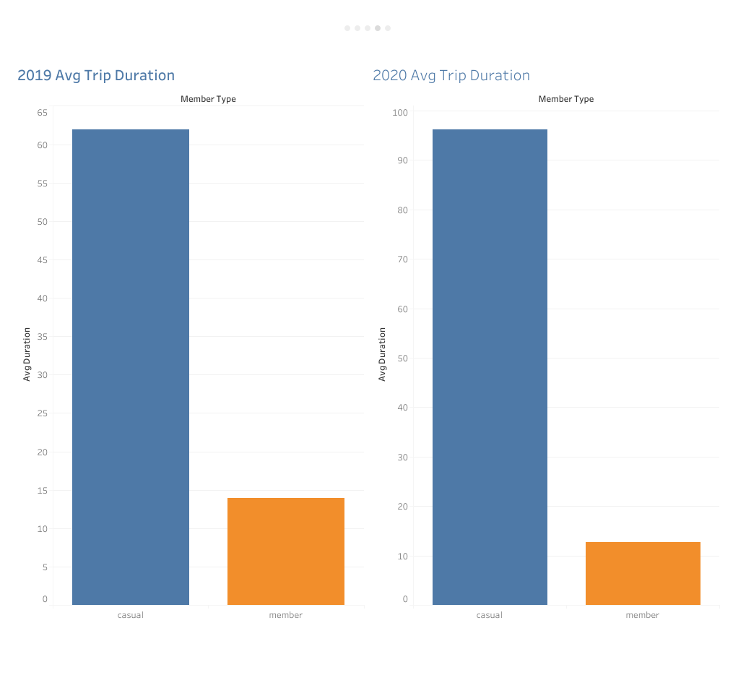
Casual Riders Lead in Trip Duration
Max trip durations for casual riders consistently double those of members in both years.
Casual riders average significantly longer trips—up to 4x the duration of members.
Members favor short, frequent utility trips, while casual riders use the service for long-duration leisure.

Slide 7
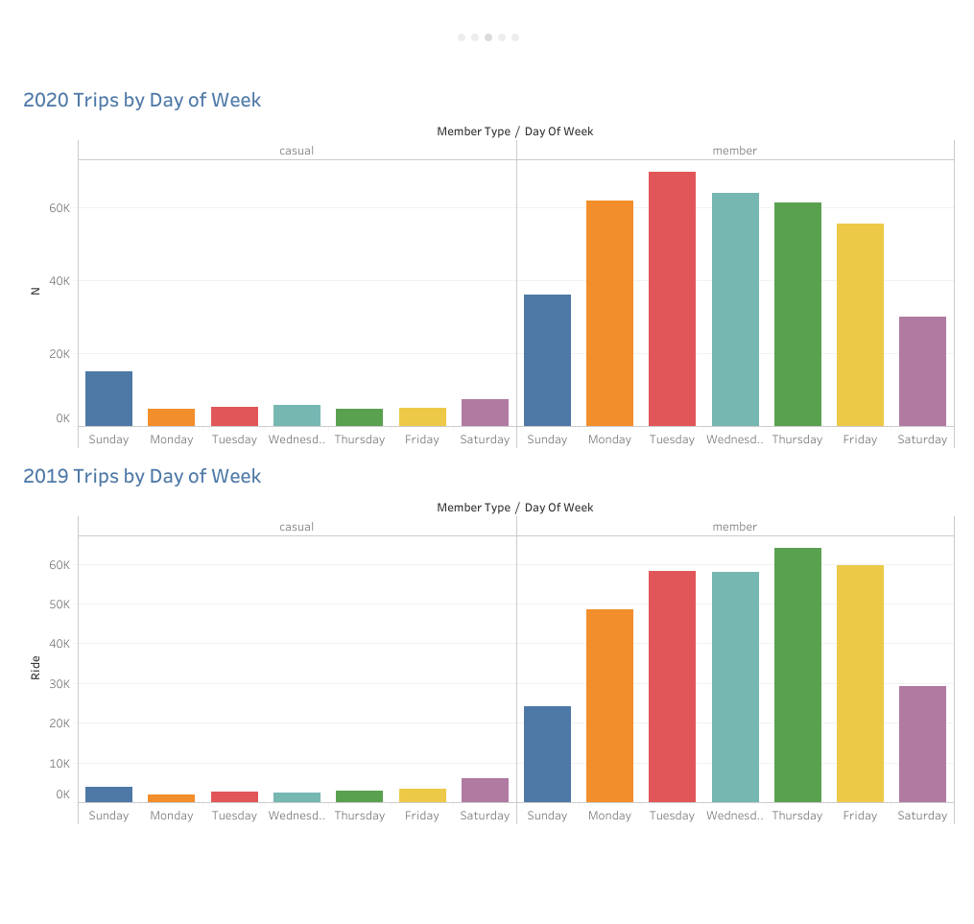
Members Ride Weekdays; Casual Riders Prefer Weekends
Annual members dominate weekday volume, peaking Tuesday through Thursday.
Casual ridership concentrates on weekends, with a notable surge on Sundays.
Casual weekend usage grew significantly in 2020 compared to 2019 levels.

Slide 8
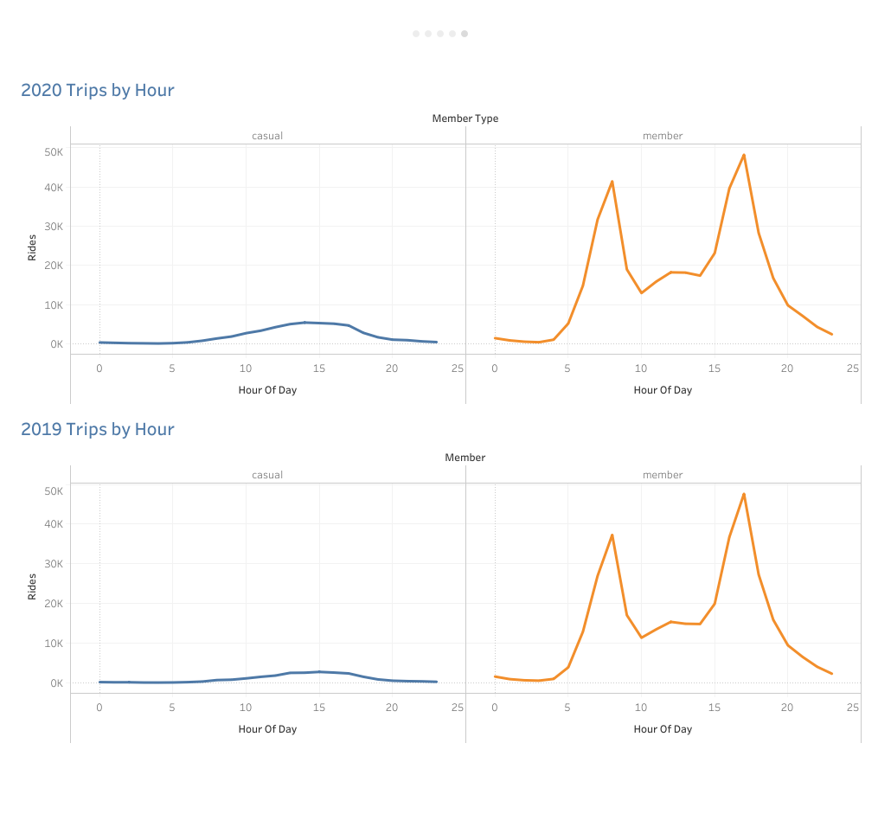
Members Ride During Commute Hours; Casual Riders Ride Midday
Annual members show sharp spikes at 8 AM and 5 PM, aligning perfectly with standard workday commute times.
Casual ridership builds steadily throughout the day, peaking between 12 PM and 4 PM without distinct commute spikes.
While both groups follow similar daily curves, member volume significantly outweighs casual volume at all hours.

Slide 9
Data-Driven Recommendations for Member Conversion

Slide 10
Appendix
Data Source: Referenced historical trip data from Cyclistic's geotracked fleet of 5,824 bicycles and 692 stations.

